Slide 1


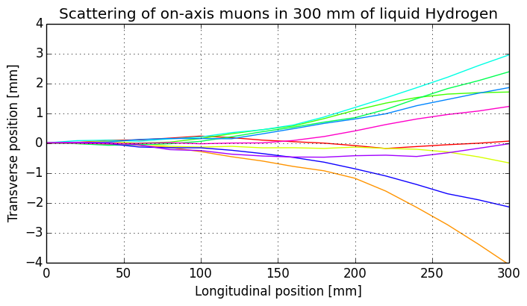
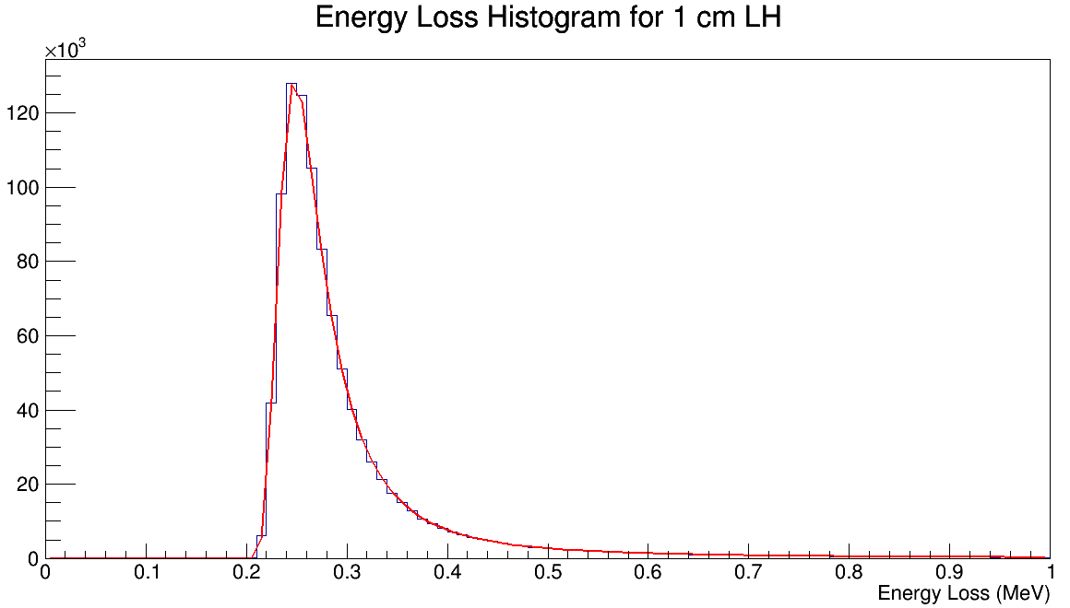
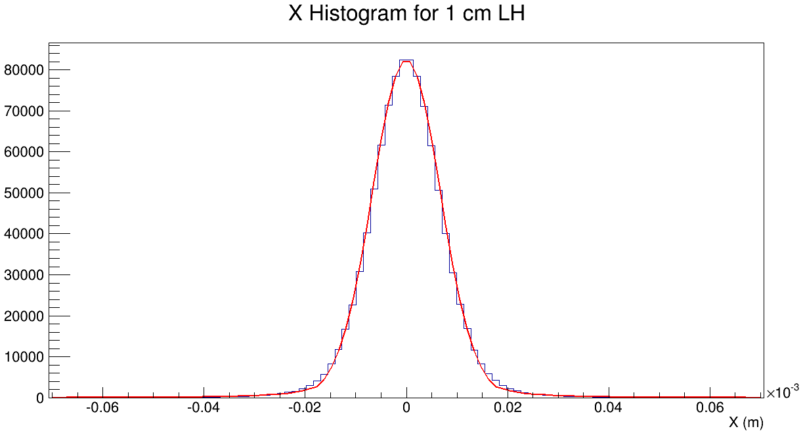
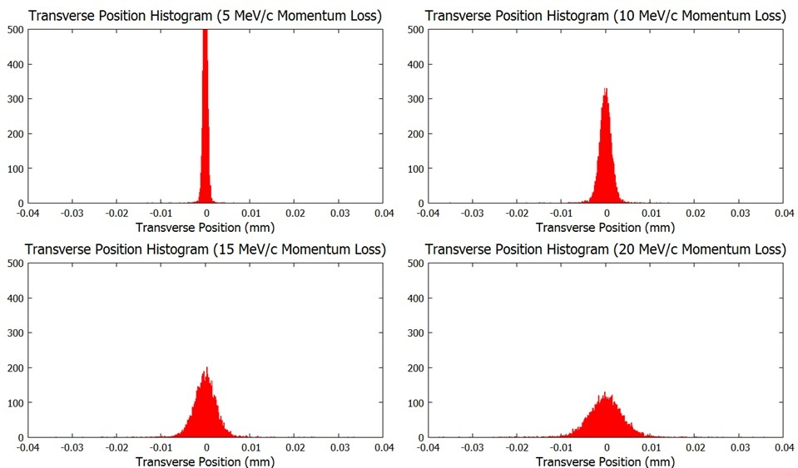
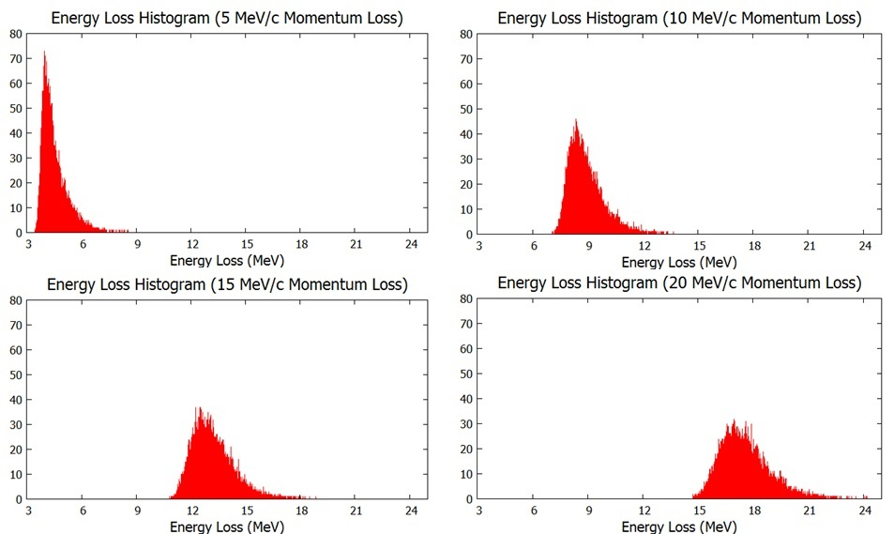
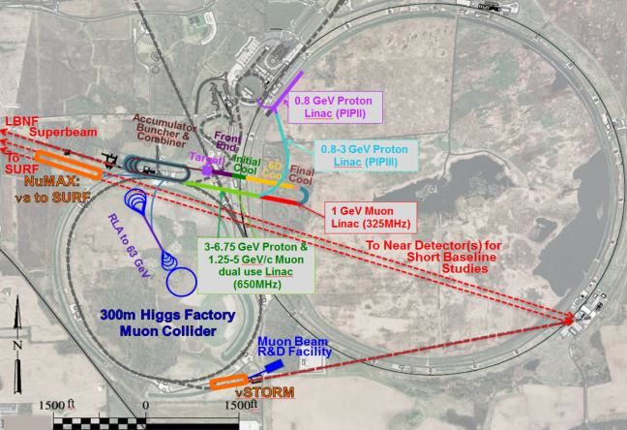
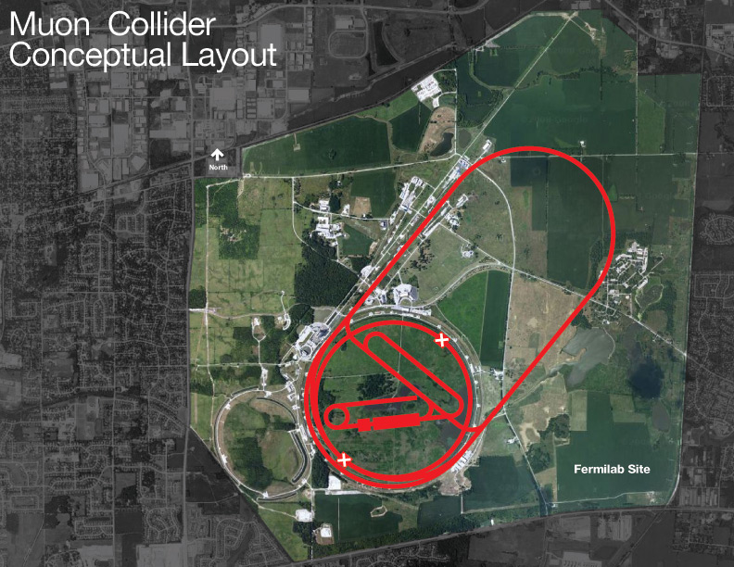
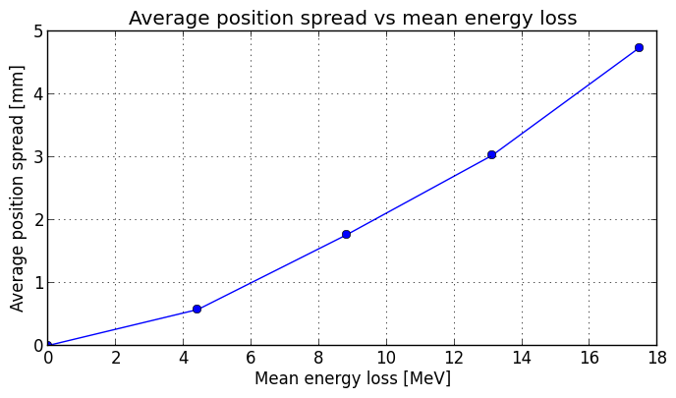
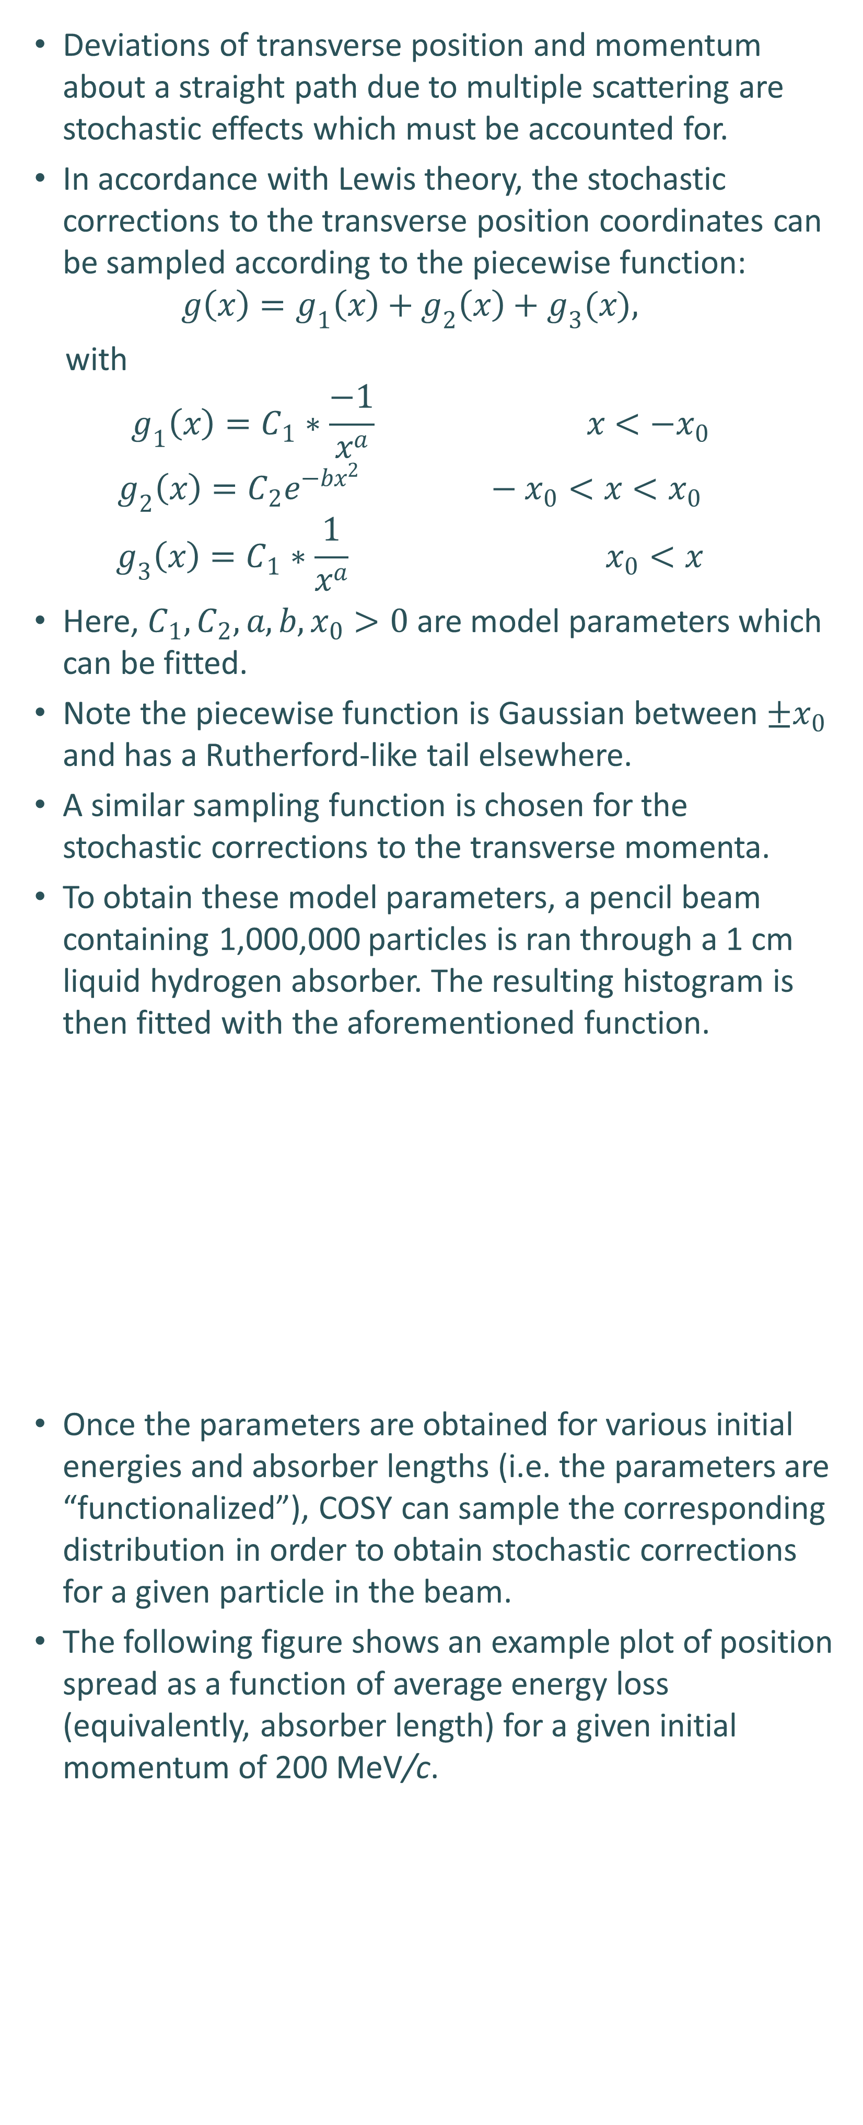

The Development of Stochastic Processes
in COSY Infinity#
J. Kunz*, P. Snopok, Illinois Institute of Technology, Chicago, IL 60616, USA
M. Berz, K. Makino, Michigan State University, East Lansing, MI 48824, USA
Introduction
Stochastic Effects
Transverse Coordinates: Multiple Scattering
Longitudinal Coordinates: Straggling
Muons for acceleration are produced as tertiary particles (protons to pions to muons) and high-intensity collection necessitates a large initial phase space volume.
The only technique fast enough to reduce the beam size within the muon lifetime is ionization cooling.
Muons pass through material, lose energy in both the longitudinal and transverse directions due to ionization. The energy is then restored in the longitudinal direction only, leading to an overall reduction in the transverse direction (cooling).
In order to achieve cooling in the longitudinal direction, emittance exchange is used, usually involving wedge-shaped absorbers.
To confirm feasibility and to perfect this technique, a detailed simulation is necessary cross-checked by multiple codes.
COSY Infinity uses transfer map techniques for fast simulations. However, currently it only supports deterministic processes when sending a beam of particles through matter.
To account for stochastic effects, a random kick is applied at the end of each absorber. The strength and type of this kick is represented as a function of the initial energy and the amount of absorber traversed.
The end goal is to use COSY’s fast transfer map method in conjunction with this “functional method” in order to simulate beams of muons as they traverse a variety of matter types.
Stochastic effects are random in nature.
An example of this can be seen in the figure below, where identical particles scatter at different angles.
If the simulation in the figure below had been executed in COSY, all particles would travel straight through without deviation.
The plots below show a pencil beam of 10,000 muons with an initial momentum of 200 MeV/c going through various lengths of liquid Hydrogen.
These random effects follow predictable patterns.
The transverse position distributions are nearly Gaussian with μ = 0. The Gaussian σ, however, depends on two parameters: initial energy and absorber length.
The energy loss variation can be characterized by a Landau distribution for thin absorbers or a convolution of Landau and Gaussian for thicker absorbers.
Deviations of transverse position and momentum about a straight path due to multiple scattering are stochastic effects which must be accounted for.
In accordance with Lewis theory, the stochastic corrections to the transverse position coordinates can be sampled according to the piecewise function:
$$g\left(x\right)=g_{1}\left(x\right)+g_{2}\left(x\right)+g_{3}(x),$$
with
$$g_{1}\left(x\right)=C_{1}∗\frac{−1}{x^{a}} x<−x_{0}$$
$$g_{2}\left(x\right)=C_{2}e^{−bx^{2}} −x_{0}<x<x_{0}$$
$$g_{3}\left(x\right)=C_{1}∗\frac{1}{x^{a}} x_{0}<x$$
Here, $C_{1}, C_{2}, a, b, x_{0}>0$ are model parameters which can be fitted.
Note the piecewise function is Gaussian between $±x_{0}$ and has a Rutherford-like tail elsewhere.
A similar sampling function is chosen for the stochastic corrections to the transverse momenta.
To obtain these model parameters, a pencil beam containing 1,000,000 particles is ran through a 1 cm liquid hydrogen absorber. The resulting histogram is then fitted with the aforementioned function.
Once the parameters are obtained for various initial energies and absorber lengths (i.e. the parameters are “functionalized”), COSY can sample the corresponding distribution in order to obtain stochastic corrections for a given particle in the beam.
The following figure shows an example plot of position spread as a function of average energy loss (equivalently, absorber length) for a given initial momentum of 200 MeV/c.
In a similar manner, deviations about the mean energy loss caused by energy straggling must be accounted for.
In this case, energy loss curves follow a Landau distribution:
$$h\left(x\right)=C∗\int_{0}^{∞}{\sin\left(2t\right)\exp\left[−t\frac{\left(x−α\right)}{β}−t\frac{2}{π}log\left(t\right)\right],}$$
where $C,α, β>0$ are fitting parameters.
These parameters can be found using curve fitting techniques similar to the ones mentioned for multiple scattering.
For thicker absorbers a convolution of Landau and Gaussian distributions was shown to give consistent results.
The functional method allows for a relatively compact storage of functional dependencies as compared to storing huge tables of numbers corresponding to each and every combination of absorber length and material, and initial energy of the particle.
The key assumption is that the stochastic effects can be represented by a known random distribution with relatively few parameters.
Motivation
Research primarily focuses on muons through matter, and specifically as it pertains to muon colliders and neutrino factories.
A 6 TeV muon collider would fit on the existing Fermilab site (deep underground), as seen below.
A muon collider as a Higgs factory (CoM 126 GeV) is also an exciting possibility, as the Higgs coupling to leptons has never been conclusively observed.
A muon accelerator could serve as a luminous neutrino beam source.
Summary
New methods are being explored and implemented in COSY to allow for the simulation of stochastic processes in matter-dominated muon accelerators.
The so-called functional method is proposed and currently under active study.
Work continues along multiple directions: find better fits describing multiple scattering and energy straggling for a variety of absorber thicknesses and muon initial energies; deduce the effects from first principles in order not to rely on any particular external code; and compare the results with experimental data.
#Work supported by the Department of Energy *kunz.josiah@gmail.com

